Slide 1
Prediction and sentiment analysis on youtube videos
Rohan Nagalkar(10403259)
Abhishek Berad(10504842)
Shantanu Jadhav(10393294)

Slide 2
Content
Business Understanding
Data Understanding
Data preparation
Modeling
Evaluation and Deployment
Conclusion

Slide 3
Business Understanding
● Analyse the people’s comments and get the sentiments analysis from the user's comments.
● Which category is the most popular and why?
● Using some machine learning algorithms like GLM to predict video views.
● Analysing what the other factors are that affect the youtube trending video

Slide 4

Data Understanding
We have collected data from kaggle.
Our dataset consist of video id, its title, category, channel type, likes, dislikes, views and comments with around 10k rows.

Slide 5
Data Preparation
As there were no missing values in our dataset but some outliers due to which we were not able to get the accuracy.
So we removed those outliers to improve the accuracy.

Slide 6
Modeling
How to choose a model in rapidminer using Auto model.
With following two factors we can choose an algorithm:
Performance: closer the correlation to 1
Rum time: Less the time required for processing better the model.
For Sentiment analysis we used python for getting unique video Ids and applied api from R to get the sentiments of each videos.

Slide 7
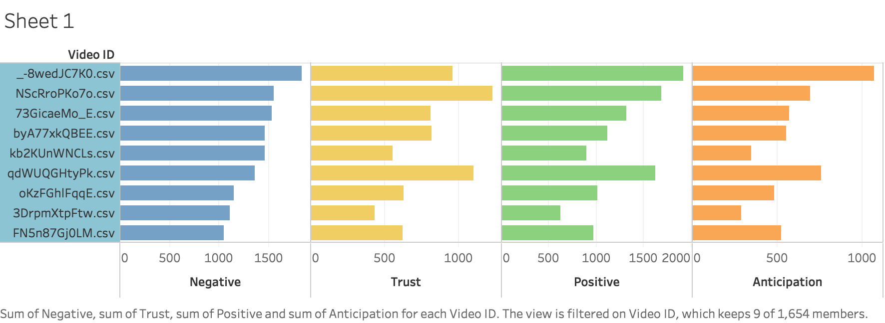
Sentiment Analysis

Slide 8
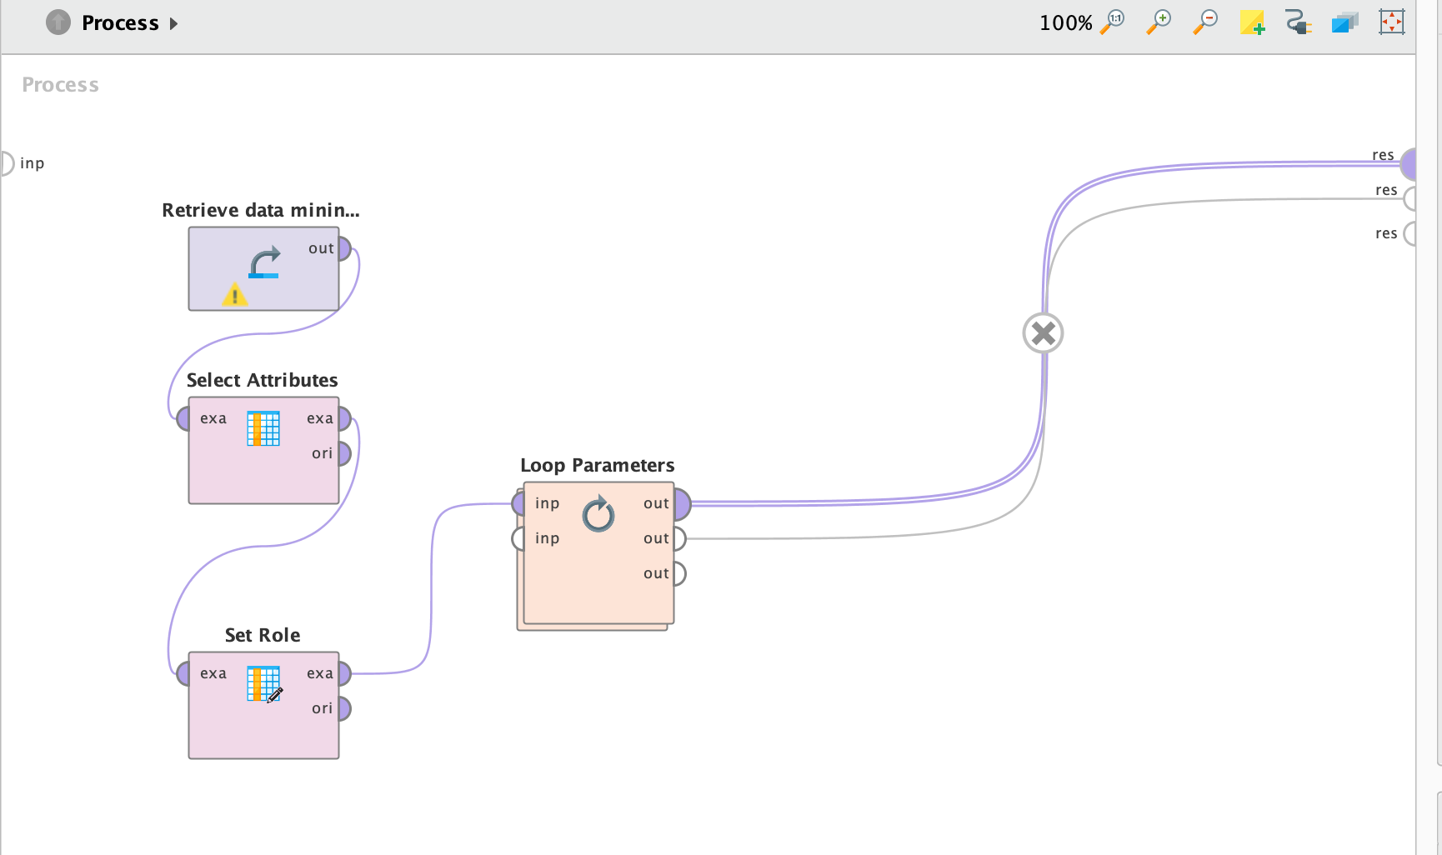
MODELING PROCESS

Slide 9
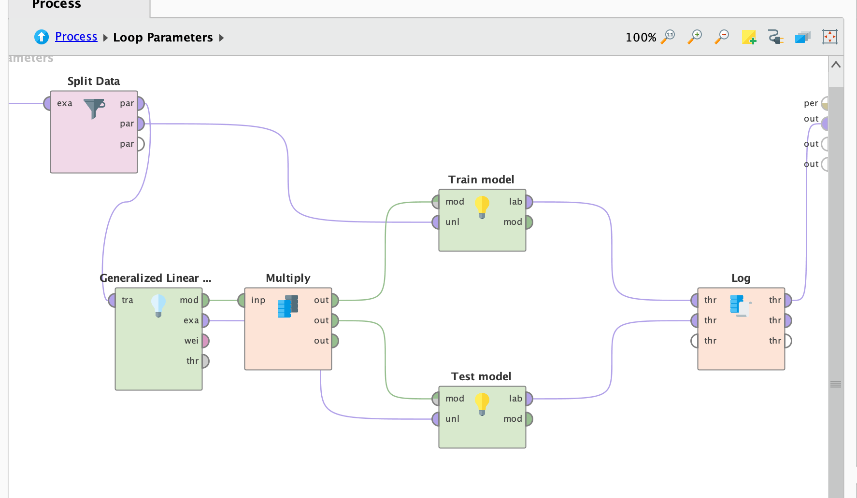

Slide 10
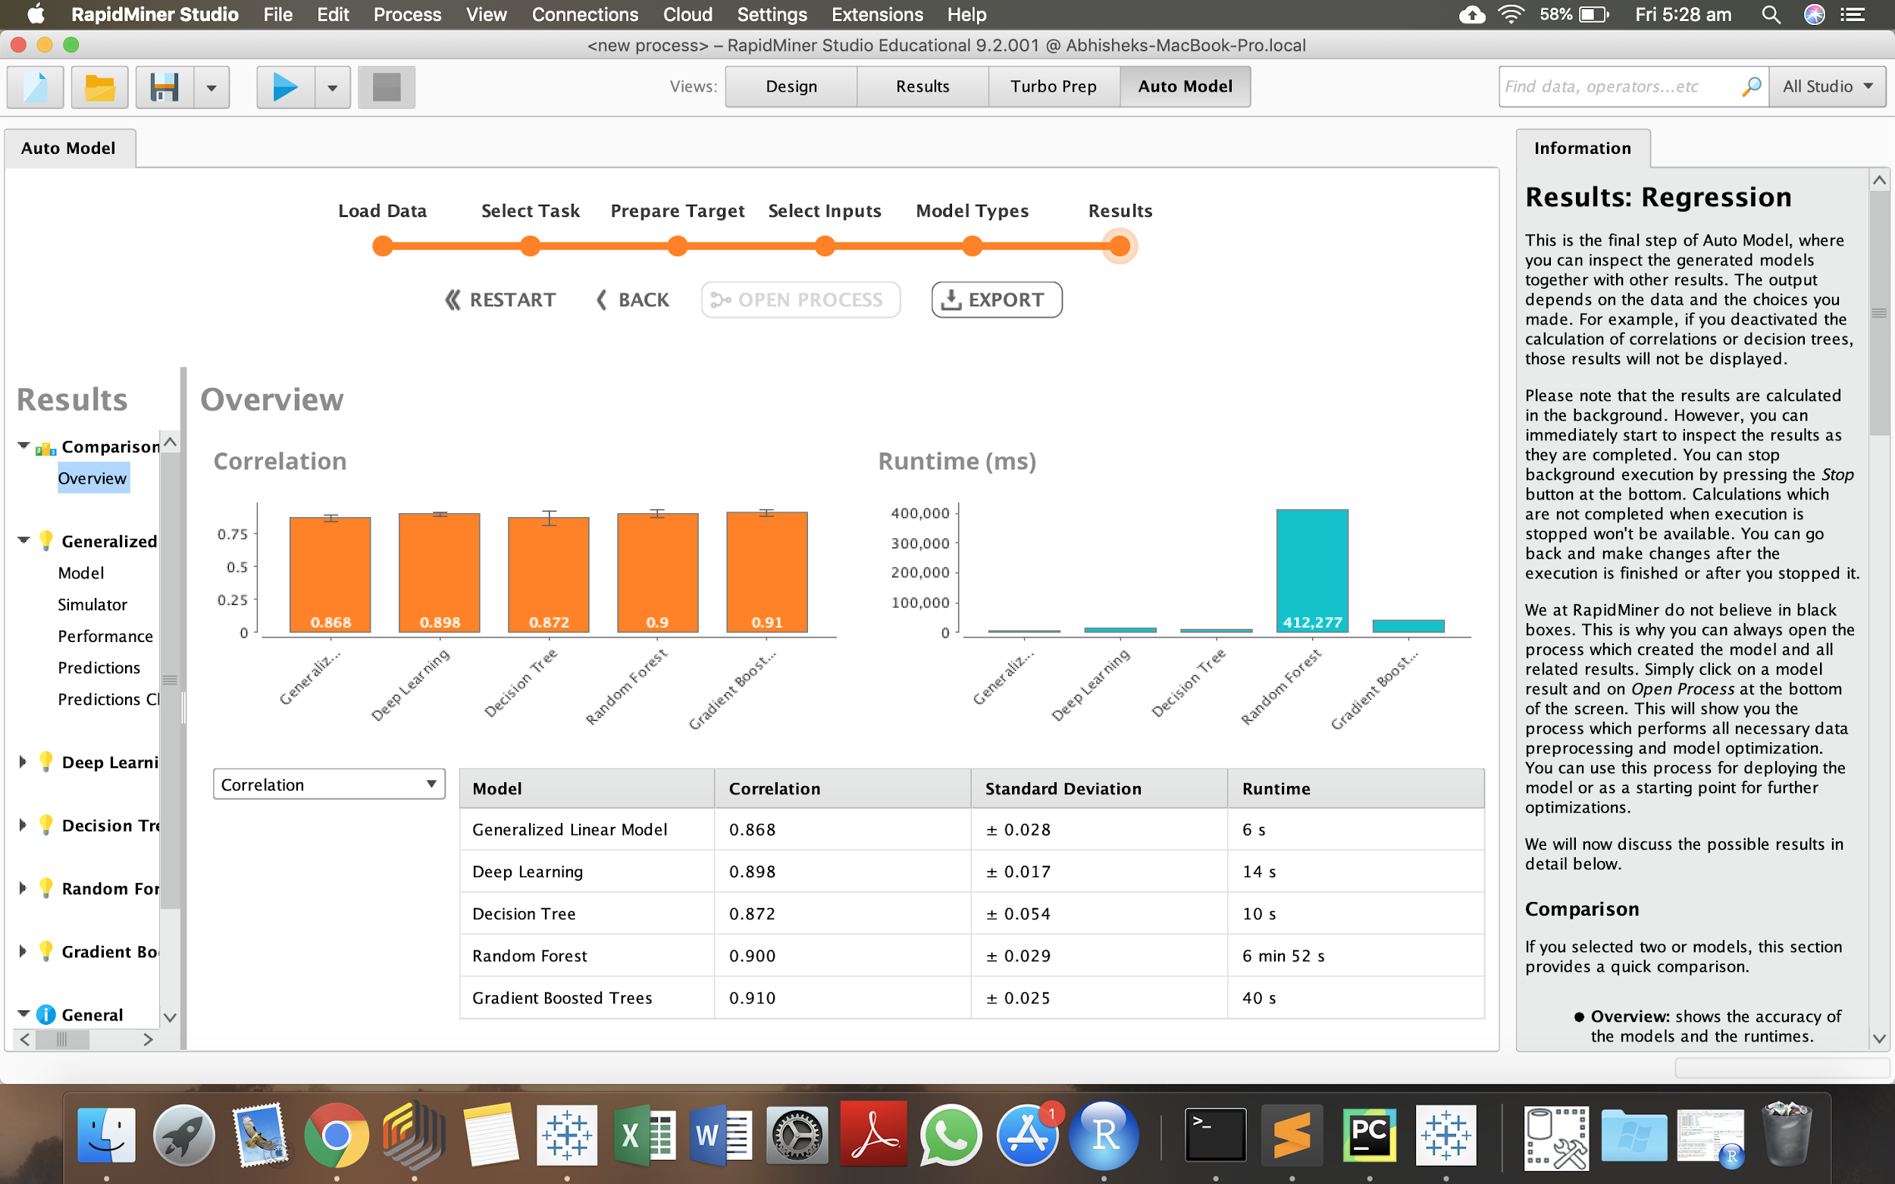

Slide 11
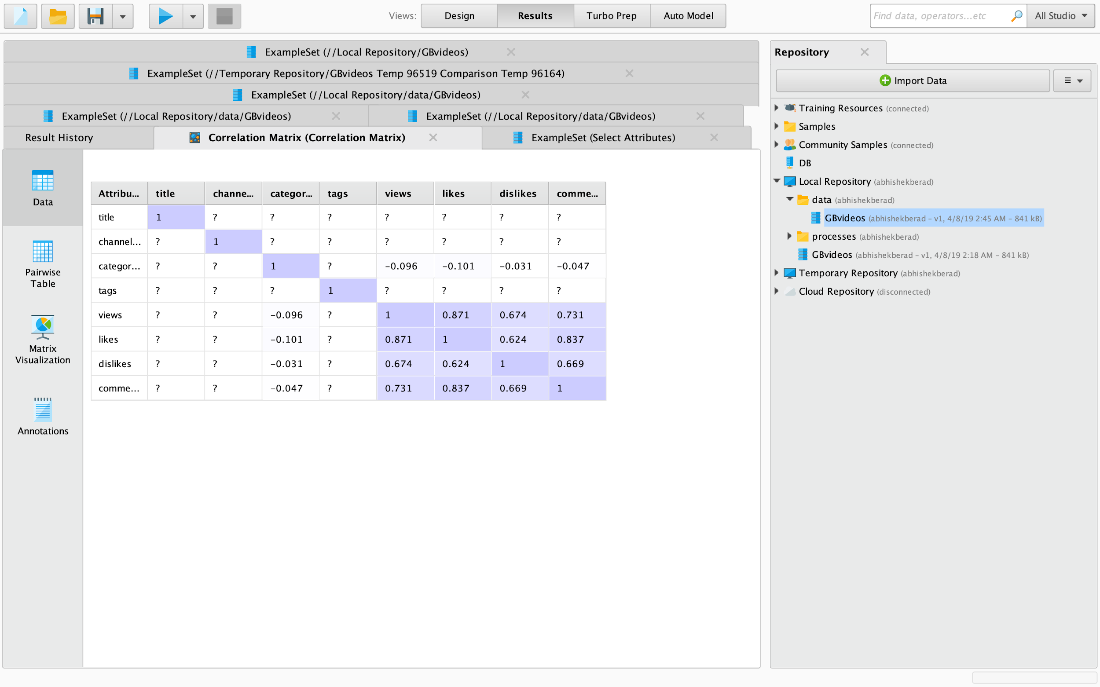

Slide 12
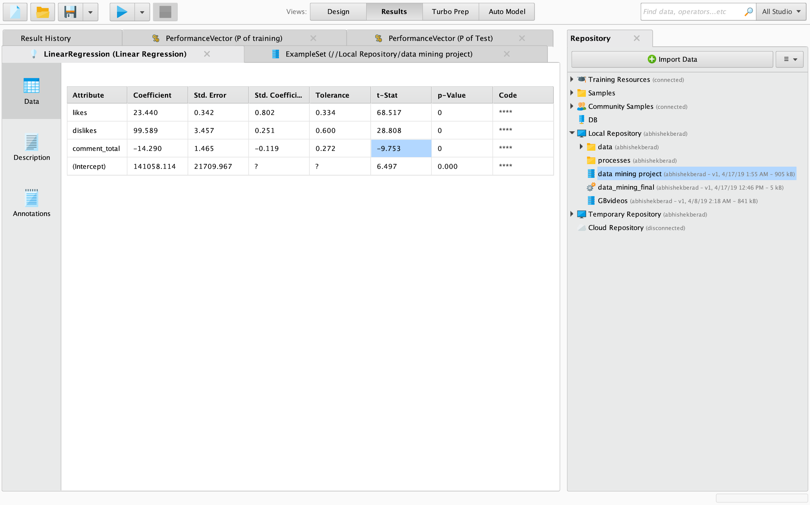

Slide 13
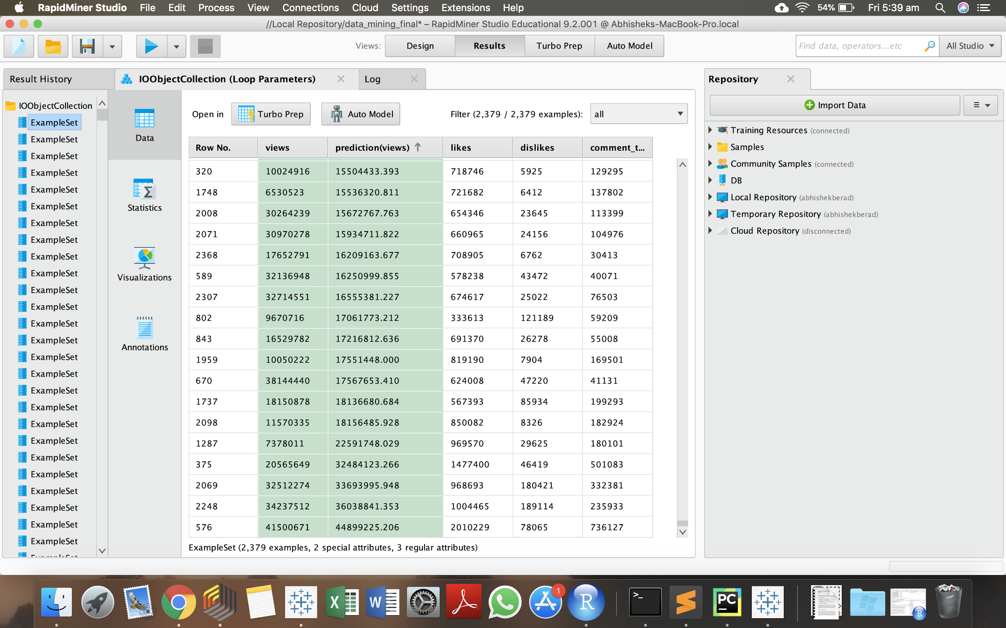

Slide 14
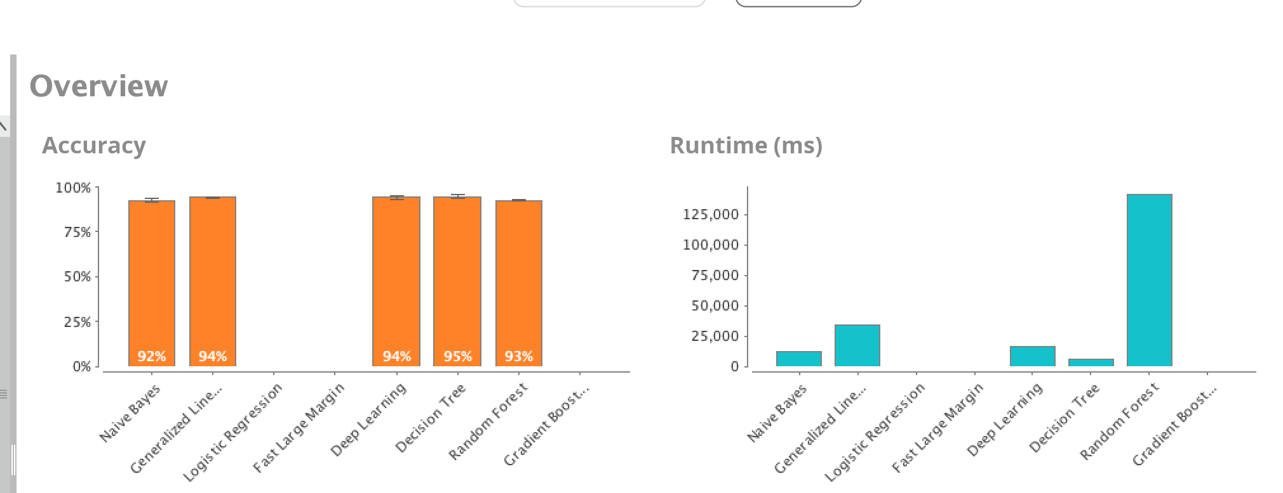
Auto model with classification

Slide 15
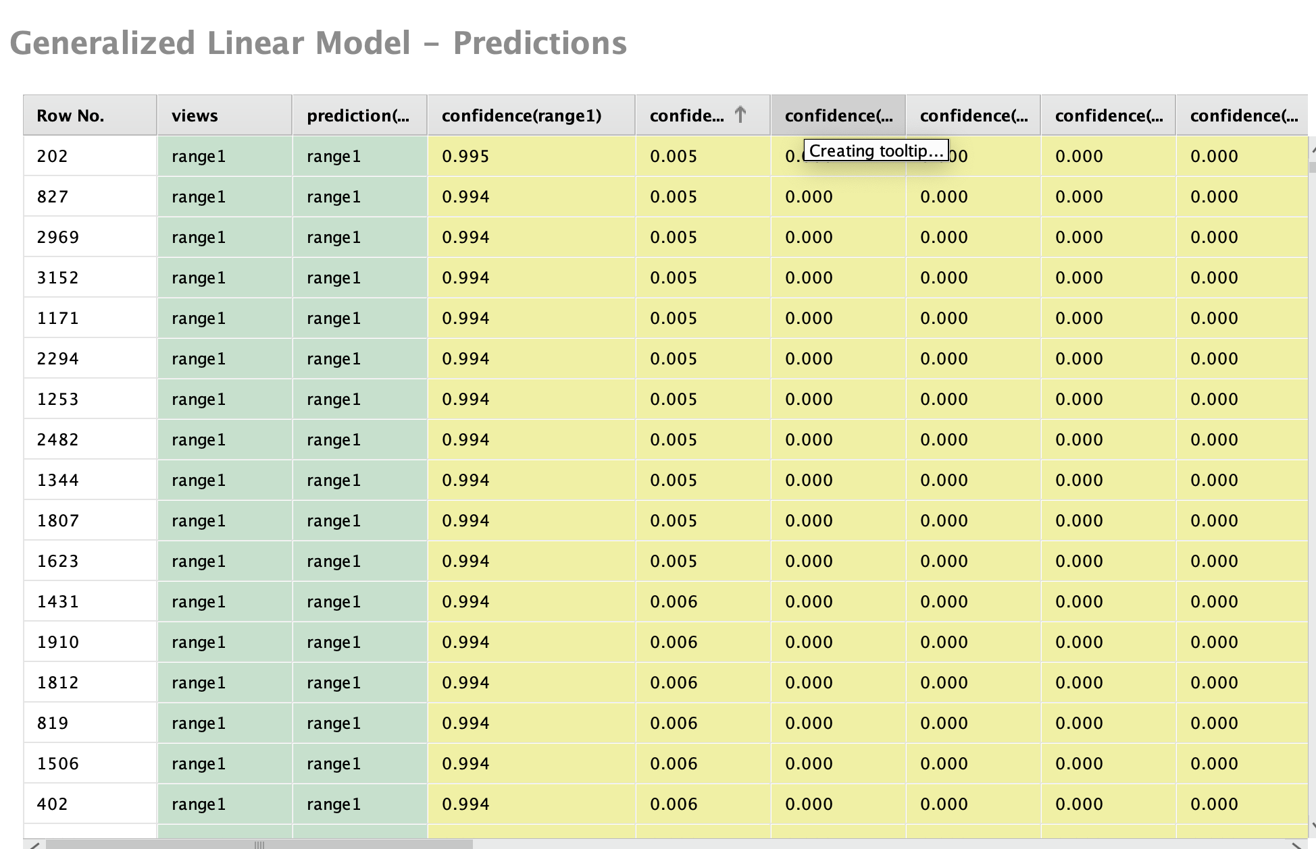

Slide 16
Thank you

